Slide 1
Lifting COVID19 Lockdown safely

Slide 2
Zones and venue details are valuable for decision
Due to the pandemic most countries have been in lockdown for months.
Countries are slowly starting to lift lockdown in phases or completely.
In order to make this decision it is important to analyse available data.
This information might be useful for people, businesses and government.

Slide 3
Data Acquisition and Cleaning
We scrape data regarding active cases in the state of Karnataka from Wikipedia.
https://en.wikipedia.org/wiki/COVID-19_pandemic_in_Karnataka
Venue details in each district are obtained using Foursquare API.
Latitude and Longitude details are obtained using Google API.

Slide 4
Data Acquisition and Cleaning
One column (sl. No.) and a row containing total values for each column was deleted.
Foursquare API did not return venue details for all 30 districts (12 districts had to be dropped due to unavailability of venue data).

Slide 5
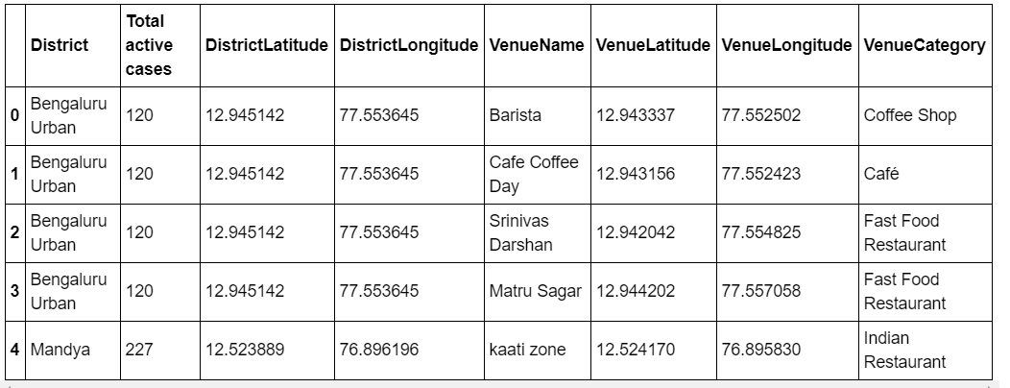
Venue Details
Foursquare API returned venues for 18 districts out of 30.

Slide 6
Number of venues in each Cluster

Slide 7
K-means Clustering
We used K-means to cluster districts based on the number of active cases which were color coded..

Slide 8
Results
The most number of venues were found in cluster 2 which contained safe zones marked with blue color.
Each district pop up could be clicked to get the number of active cases and cluster details.

Slide 9
Conclusion and Future Directions
Useful analysis done to help ease the lockdown.
Districts were clustered into safe and containment zones (based on the number of active cases) and venue details in each zone were analysed.
In a follow up analysis we can cluster wards in each districts.
Since Foursquare API did not return venue details for 12 districts, we can use some other dataset for venues (for e.g. google).

